Slide 1
GameVibes: Vibration-based Crowd Monitoring for Sports Games
through Audience-Game-Facility Association Modeling
Presenter: Isaac Tourner, Kunal Siddhawar, Zo-Vic Shong
November 11th, 2025

Slide 2
Zo Vic
Summary
It should include a short summary and then explore the area of the paper. To help you prepare going forward, here are a few questions you can consider including.
What are major companies that supply products (e.g. software, hardware, etc.) or services (e.g. cloud services like Amazon EC2, training, etc.) relevant to this course topic? Are these well-established companies or startups? Who are the primary customers: individual users, small businesses, large enterprises, etc.? Briefly describe these goods and services.
Isaac
How is the marketplace segmented? What is the basis of the segmentation? In each segment, which are the major and minor players? ​
What is the business model? How do the companies make money? What are the major costs involved? Do these business models trigger any significant policy issues (e.g. privacy)?​ ​
What are the major standards in this arena? Are these official standards or informal standards that have evolved?
Kunal
Are there capabilities discussed in the research papers for this topic that are missing from the marketplace? What might be the reasons for this gap?​
Does commercial practice reveal important unaddressed research topics? Why have these topics not been investigated?​ ​
Are there significant unmet needs in this space? Why have these needs remained unmet?​

Slide 3


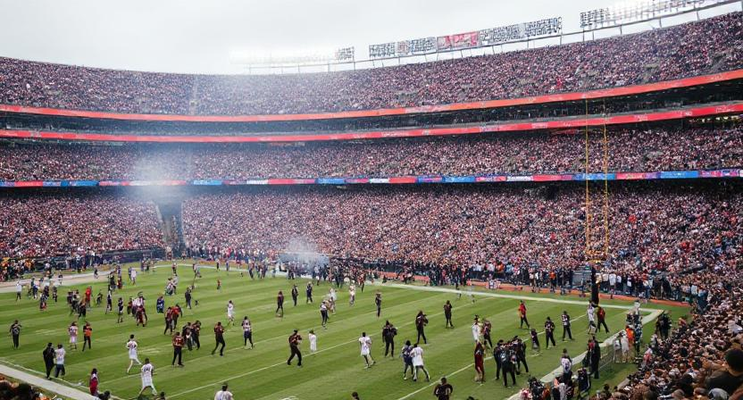
Summary - The Problem
Core Problem:
Current crowd monitoring systems in large public venues (stadiums, arenas) fail to balance accuracy, cost, and privacy.

Slide 4
Summary - Why is it important
Safety: Prevent disasters like stampedes and riots (e.g., Kanjuruhan Stadium, Seoul Halloween Stampede).
Security: Detect risky crowd dynamics or unusual movement.
Experience: Understand audience engagement and reactions.
Operations: Optimize gate usage, staffing, and facility management.
Notes:
Proper crowd monitoring is critical for ensuring public safety and security in large-scale public spaces, in addition it could also increase the experience of the audience and efficiency of operations

Slide 5
Summary - Existing Solutions
Method | Pros | Cons
Manual Observation | Direct, human judgment | Costly,delayed,inconsistent
Video / Audio Systems | High accuracy | Privacy concerns, data overload
WiFi / RF Tracking | Wide coverage | Noisy, inconsistent signals
Wearables / Apps | Individual accuracy | Poor scalability
Questionnaires | Social/behavioral insights | Not real-time

Slide 6
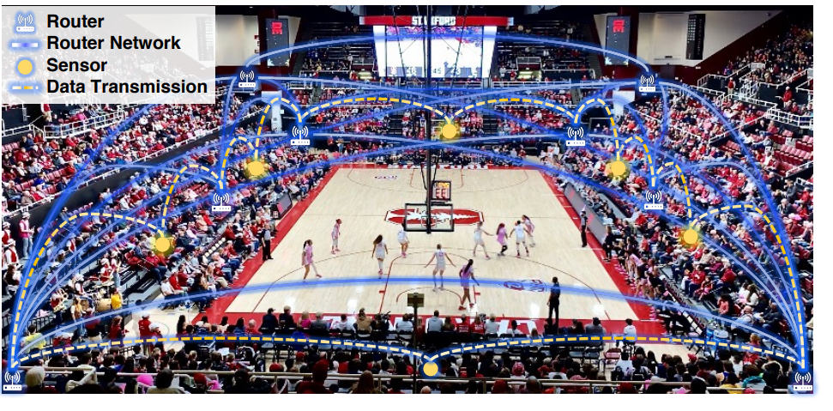
Summary - GameVibes Approach
Core Idea: Use floor-mounted vibration sensors + contextual modeling to infer crowd reactions and traffic.
Key Components:
Game Associations (Temporal Context):
Link reactions (clapping, stomping) to game progress.
Facility Associations (Spatial Context):
Link traffic flow to layout features (doors, food stands).
Neural Network Encoders:
Model the features and relationships within the data to estimate crowd behaviors.
Notes:
GameVibes uses floor-mounted vibration sensors to detect how crowds behave in a stadium. When people cheer, stomp, or walk, those actions create unique vibration patterns. The system adds context — looking at when events happen and where in the stadium they occur — to interpret these vibrations accurately.”
“It does this through three parts: Game Associations connect vibrations to game events in time; Facility Associations link them to locations like doors or stands; and Neural Encoders use AI to learn these patterns and make precise predictions.”

Slide 7
Summary - Why It’s Better
Privacy-Friendly: No images or sound collected.
Low-Cost & Scalable: Uses inexpensive vibration sensors.
Context-Aware: Models why vibrations happen, not just when.
Robust: Works across different venues and sensor locations.
Results (Stanford Maples Pavilion):
0.9 F1 Score (crowd reaction detection)
9.3 Mean Absolute Error (traffic estimation)
~10–12% increased accuracy improvement vs. baselines.
Notes:
GameVibes correctly identified about 90% of crowd reactions — very high accuracy. How close the system’s crowd-traffic estimates are to the actual number of people moving through doors.
Meaning: On average, the system’s prediction differs by about 9 people from the real count per measurement.

Slide 8
Industry Ecosystem
Established Companies:
Bosch: Manufactures IoT and vibration sensors; smart infrastructure analytics.
Honeywell: Building automation, safety systems, and industrial monitoring.
Siemens Smart Infrastructure: Occupancy, motion, and structural sensing for large venues.
Startups:
Density.io: Radar-based, anonymous people-counting sensors for buildings and arenas.
Notes:
This slide shows the industry ecosystem — the companies and technologies that already exist in the same space as GameVibes.
Big players like Bosch, Honeywell, and Siemens provide the sensors and infrastructure,
Meanwhile, startups such as Density.io focus on privacy-safe crowd monitoring

Slide 9
Potential Primary Customers
Large Enterprises: Stadiums, airports, factories: Operate large facilities needing real-time crowd and safety management systems.
Government / Smart City Planners: Manage public safety, traffic flow, and smart infrastructure using integrated sensing and analytics.
Event Organizers: Sports leagues, concerts, and festivals: Use crowd analytics to ensure safety and enhance audience experience.

Slide 10
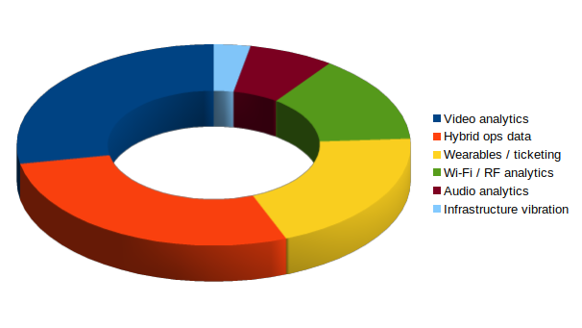
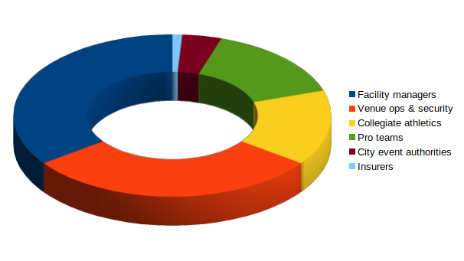
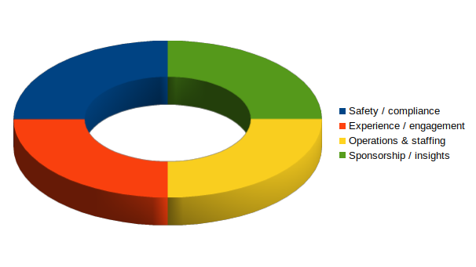
Market Segmentation: “How is the marketplace segmented?”
By sensing modality & data source
By buyer
By value proposition
Notes:
Explain what Pie charts mean to market!!
By sensing modality & data source
Video analytics (CCTV/edge AI)
Audio analytics (microphones, sound events)
Wi‑Fi / RF analytics (probe requests, localization)
Wearables / ticketing devices (RFID/NFC, apps)
Infrastructure vibration sensing (geophones/accelerometers)
Hybrid ops data (game logs, door counters, POS, maps)
By buyer
Venue ops & security, collegiate athletics, pro teams, facility managers, city event authorities, insurers.
By value proposition
Safety/compliance, experience/engagement, operations & staffing, sponsorship/insights.

Slide 11





Basis of Segmentation: “What’s the basis?”
Privacy sensitivity
Cost & deployability
Context integration
Coverage & granularity
Robustness in noise / crowds
Notes:
Market Segmentation - vendor thinks of these points when selling a device
From business standpoint these are the dominant factors that go into building such a device
Privacy sensitivity: Cameras & mics vs. privacy‑friendlier signals (vibration, ticketing).
Coverage & granularity: Seat‑level reactions vs. door‑level traffic vs. venue‑wide headcounts.
Cost & deployability: CAPEX (hardware count, wiring) + OPEX (maintenance, data) vs. mesh/portable nodes.
Robustness in noise/crowds: RF congestion, acoustic/music interference, occlusions vs. structure‑borne signals.
Context integration: Ability to fuse game events and facility layout to reduce uncertainty.

Slide 12











Players by Segment: “Major players?”
Video analytics
Hybrid ops data
Wearables / ticketing
Wi‑Fi / RF analytics
Audio analytics
Infrastructure vibration
Notes:
LOOK FOR SPECIFIC NAMES OF COMPANIES!!
Framed as types of companies rather than brand lists; emphasis on where GameVibes‑like solutions fit.
Video analytics
Major: Camera OEMs, VMS/analytics platforms, venue‑scale integrators.
Minor/Niche: Startups focusing on specific events (e.g., stampede detection), research labs.
Audio analytics
Major: AV integrators, acoustics analytics vendors.
Minor: Niche providers for chant/decibel engagement.
Wi‑Fi / RF analytics
Major: Network infrastructure vendors (APs, controllers), location‑analytics platforms.
Minor: Device‑free RF sensing startups, UWB pilots.
Wearables / ticketing
Major: Ticketing platforms, access control/turnstile providers.
Minor: Event wristband/IoT badge startups.
Infrastructure vibration (GameVibes segment)
Major: Currently research‑driven & systems‑integration‑led (universities + venue partners).
Minor: Sensor OEMs (geophones/IMUs), bespoke solution integrators.
Hybrid ops data
Major: Venue ops systems (score feeds, scheduling, POS).
Minor: Data fusion/BI layers purpose‑built for arenas.

Slide 13
Business Models: “How do companies make money? Major costs?”
Revenue models
Hardware + install
Software licensing / SaaS
Data services
Systems integration / support
Cost drivers
Hardware CapEx
Ops OpEx
Labeling & ground truth collection
Model development & tuning
Notes:
Revenue models
Hardware + install: Sensors (cameras, mics, geophones), routers/mesh nodes, mounts, power.
Software licensing / SaaS: Analytics dashboards, model hosting, alerting; per‑venue or per‑event pricing.
Data services: Historical analysis, staffing optimization, safety audits; managed services.
Systems integration / support: Design, deployment, calibration, venue mapping, SLAs.
Cost drivers
Hardware CAPEX: Sensor units, networking (esp. density to survive crowds), edge gateways.
Ops OPEX: Battery swaps/maintenance for portable nodes, storage/compute for high‑rate data, network fees.
Labeling & ground truth collection: Volunteer/ops time; data cleaning.
Model development & tuning: Feature engineering, encoder training, association modeling.
GameVibes‑style edge: Lower privacy burden, fewer cameras; portable, event‑duration deployments; leverages game/facility context to reduce required sensor density.

Slide 14
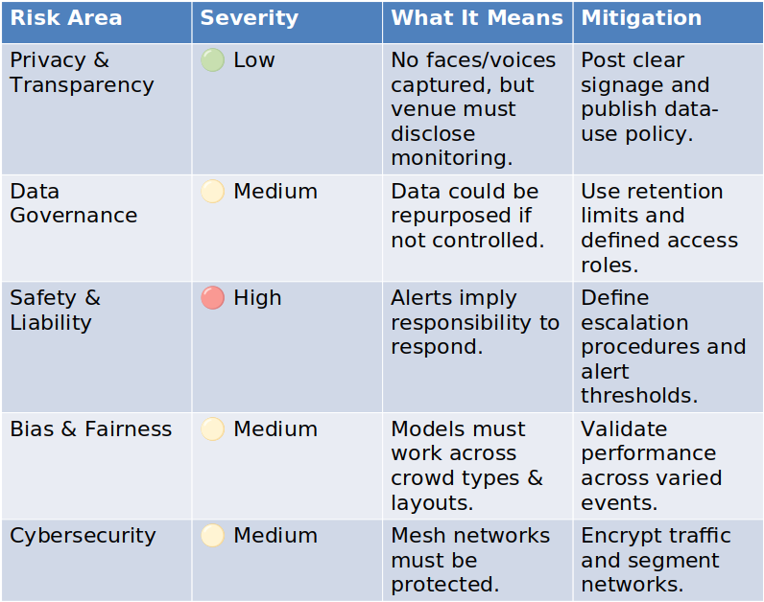
Policy & Risk: “Do models trigger policy issues (e.g., privacy)?”
Notes:
“These are the terms that you will usually see in policies, I’ll explain each one”
Say risk area/severity, then what it means/what people are currently doing to bypass it
Privacy: Cameras/mics record PII/voices; higher compliance overhead. Vibration signals are perceived as more privacy‑friendly (no faces/voices), but still need signage & data policy.
Data governance: Retention limits, purpose limitation, access control; research vs. commercial use.
Safety & liability: Use for early warnings (surge detection) raises expectations for response; document thresholds & SOPs.
Bias & fairness: Different crowd compositions; ensure models generalize across events/teams; avoid intrusive differentials.
Cybersecurity: Mesh networks in crowded RF environments; segment networks; monitor for packet loss impacts.

Slide 15
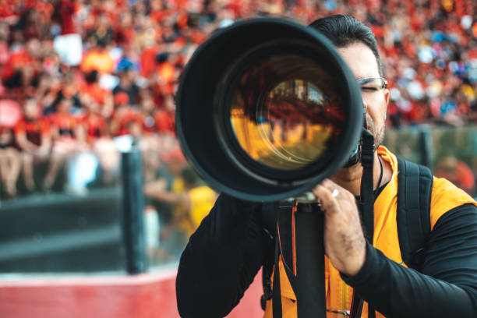
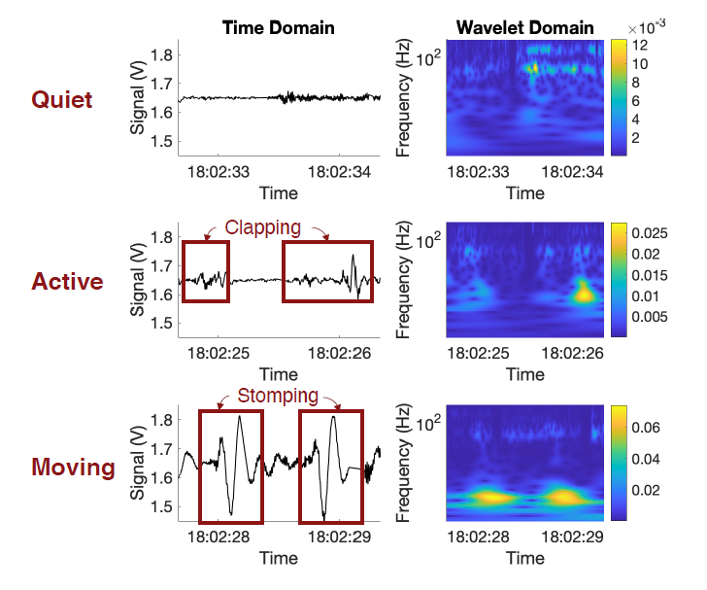
Privacy vs. Life??
CCTV or Person Monitoring Floor vibration Monitoring

Slide 16
The Market Reality
Current Products
Stadiums deploy AI cameras (e.g., NEC, SAFR) despite privacy pushback
Sporting Kansas City facilities
UEFA Super Cup Final 2020
Surveillance acceptance rises only after tragedies (e.g., Seoul 2022, Kanjuruhan 2022)
**These commercial tools save lives but sacrifice privacy, What if we didn’t have to choose??

Slide 17
Why Market Adoption Lags Behind Research
Barrier | Explanation
⚙️ Structural variability | Stadium floors differ; hard to generalize models
💾 Limited datasets | Few long-term, multi-venue vibration datasets
💰 ROI uncertainty | Hard to prove cost-benefit to venue operators
🧯 Liability & inertia | Safety tech adoption moves slowly due to regulation

Slide 18
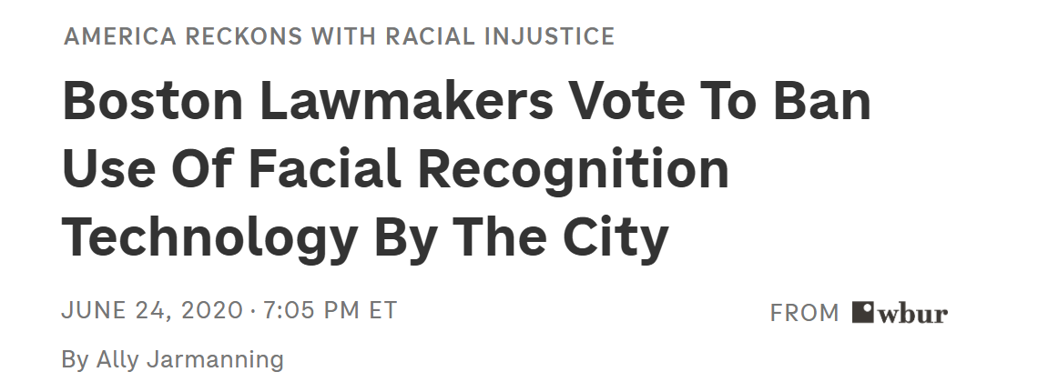
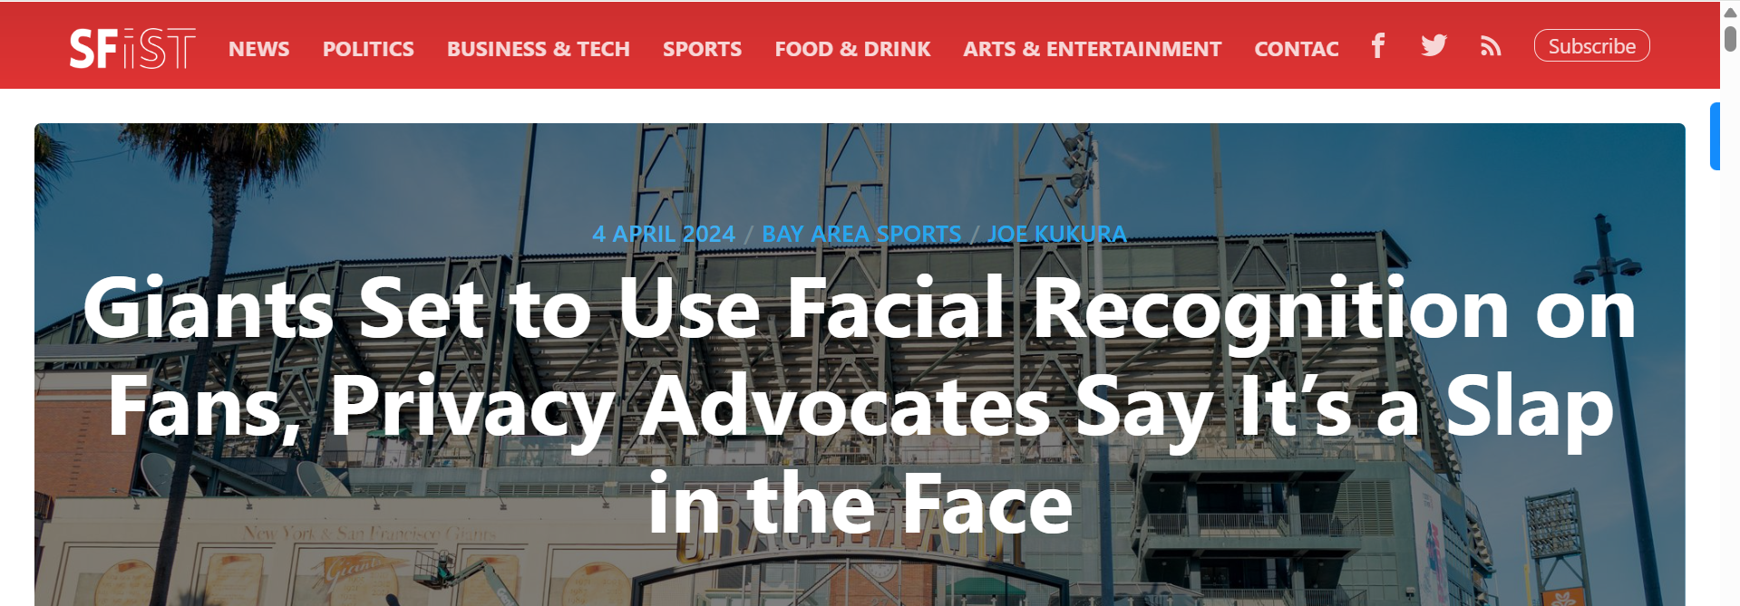
Video Surveillance: Legal but Limited - The Smart Monitoring Gap
Regulatory Restrictions on AI Features
Facial recognition: Banned (EU, 20+ US cities) or requires consent (Illinois, California)
Emotion detection: Banned in EU for most uses
Privacy Perception & Reputational Risk
Madison Square Garden facial recognition scandal (2022)
Taylor Swift concert facial recognition outrage (2018)
Safety
Privacy

Slide 19

Crowd Monitoring WITHOUT the Regulatory Risk
EU alone:
27 countries
~300-500 stadiums per major country (Germany, France, UK, Italy, Spain)
US privacy-strict cities:
20+ cities with facial recognition bans
Average 50-100 venues per city (including high schools, colleges, pro)
Safety
Privacy
GameVibes

Slide 20
Thank You!
Any Questions?
(Don’t worry you are not being recorded)

